Slide 1
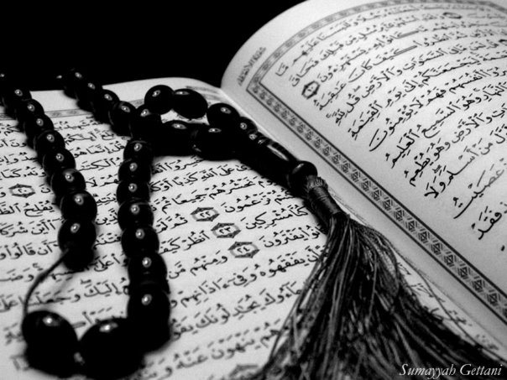
Qur`an Appreciation

Slide 2
QA

Slide 3
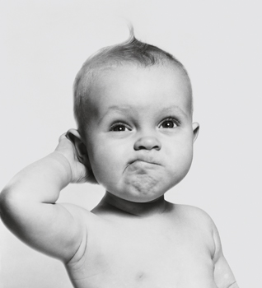
QA
Lesson 6
LO:
Summary of Verses 11-18
Reflection
Starter:
Write down 5 names of the Holy Qur`an as it describes itself?
Can you give their meanings?
Notes:
e.g:
Al-Furqaan – The Criterion
Al-Kitaab - The Book
Al-Zikr – The Rememberance/Reminder
Al-Noor – the Light
Al-Huda – The Guide
Al-Mubin – The Luminous
Al-Kareem – The Noble
Al-Majid – The Glourious
Al-Hakim – Full of Wisdom
For more refer to: http://www.iqra.net/names/QuranNames.html

Slide 4
Summary of Vs 11-18
QA
Prophet Yusuf’s (as) brothers knew their father didn’t trust them with him so persuaded him to allow them to take him out with them
In front of their father, they pretended to love Prophet Yusuf (as) and only want what is best for him
They agreed to throw him in a well and take back a blood stained shirt to show their father
He knew they were lying but was patient in his grief

Slide 5
Summary of Vs 11-18
QA
What do these verses show us?
We can not prejudge people or act in offence (we should only act in defence – innocent until proven guilty)
Lying can work for a short time, but will always be overcome by truth
Patience is bearing hardship without complaining
Relying on Allah (swt) will ensure success even when things seem tough

Slide 6
Reflection
QA

Slide 7
Reflection
QA
Have a look at one or more of the following..
Lying – why it happens, what it can lead to, how to combat it. Is it ever ok? Personal experiences?
Patience – how to bring it about. How can you be patient and also stand up against injustice? (isn’t that being impatient?)
Reliance on Allah (swt) – What is our role then? How much do we rely on Him? He has given us intelligence should we not use it to solve our problems?

