Slide 1
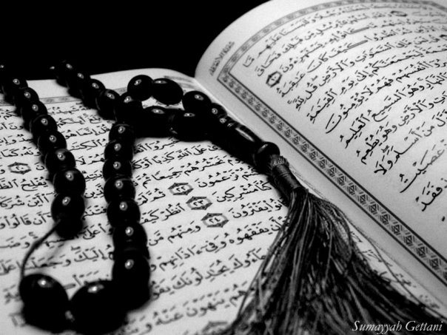
LESSON 6
Special verses in the Holy Quran
Qur`an Appreciation

Slide 2
Learning Objectives:
To know that the Ayat ul Kursi is in Surah Baqarah
To begin to understand the meaning of Ayat ul Kursi
To be familiar with some merits of reciting Ayat ul Kursi

Slide 3
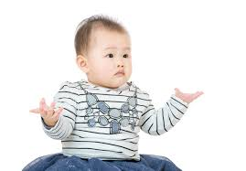
Does anyone know in which Sura in the Holy Quran we can find ayat ul kursi?

Slide 4
Surah Baqarah
Ayat ul Kursi
(2:255-257)

Slide 5
The verses 255, 256 and 257 of Suratul Baqarah are collectively known as Ayatul Kursi.
The three verses have great merit and blessing and it is highly recommended to memorise them and recite them often.
They protect the reciter from all harm.

Slide 6
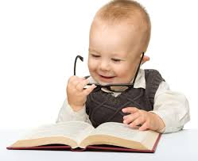
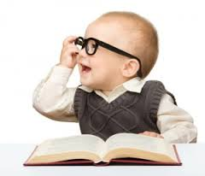
Let’s read Ayat ul Kursi from our books!
Notes:
Children to recite a line each, first arabaic then english translation.
Stop them after each line to discuss what the line may mean.

Slide 7
Simple Tafsir: Ayat 255
In this one verse is contained all we can ever know about Allah. There is no god but He. He is never inattentive to the needs of His creation.
On the Day of Judgement, there will be no intercession for anyone except with Allah’s permission.
“Kursi” means “chair”, but here it refers to the knowledge and authority of Allah.

Slide 8
Simple Tafsir: Ayat 256
‘There is no compulsion in religion’ means that you cannot force anyone to accept Islam.
A Muslim was forcing his slave to become Muslim when this verse was revealed. It does not mean that we do not have to follow the rules of Shar`ia once we become Muslims (as some people think.)
According to Imam Muhammad al Baqir (A), the strong rope “al ‘Urwatul Wuthqa” refers to following the guidance of the Holy Aimmah (AS).

Slide 9
Simple Tafsir: Ayat 257
In this verse, “Wali” means that Allah is close to the believers while the disbelievers are under the influence of the “Taghut” or Shaitan.
While Allah brings people out of the darkness of ignorance into the light of knowledge, Shaitan takes his followers into the darkness of disbelief.

Slide 10
Why should we recite Ayat ul Kursi?

Slide 11
If recited after namaz for increase in sustenance and livelihood
The Prophet (S) has said, “O `Ali! Whoever recites Ayatul Kursi after the obligatory prayers will be protected by Allah against all troubles, and remain under His protection and peace till the next prayer time.”
The Prophet (S) has said, “I am alone in having been favoured with Ayatul Kursi by Allah. This favour has not been granted to any other Prophet.”
MERITS OF RECITING AYAT UL KURSI
Imam `Ali (AS) has said that he who recites it before going to sleep ensures his protection as well as that of his neighbours.
Imam Ja`far as Sadiq (AS) has said that before you go on a journey, recite Ayatul Kursi and give something in charity.
This will secure your life and property during the journey.

Slide 12
Plenary:
What Surah is Ayat ul Kursi found in?
What does ‘KURSI’ mean?
Can you recall some merits of reciting Ayat ul Kursi?

