Slide 1
Lesson 6

Slide 2
Prophet Musa (A)’s early life in the palace
Learning objectives:
Learning about the life of Prophet Musa (A) within the palace.
To understand that even though living in a corrupt environment one can still become one of the Muhsineen.
For students to continue with the memorisation of Surat al-A’la verses 9 –13.

Slide 3
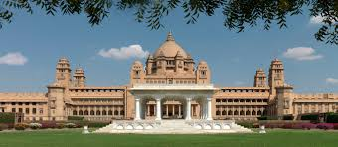
Prophet Musa was raised in a palace as though he was a loved son of the pharaoh

Slide 4
Although Prophet Musa could have drunk alcohol he didn’t!
He could have committed any crime but chose not too. Due to his good behaviour Allah swt blessed him.

Slide 5
Look up this verse!
[ 28:14]
When Allah (swt) wanted to bless Prophet Musa he didn’t bless him with wealth and power why?

Slide 6
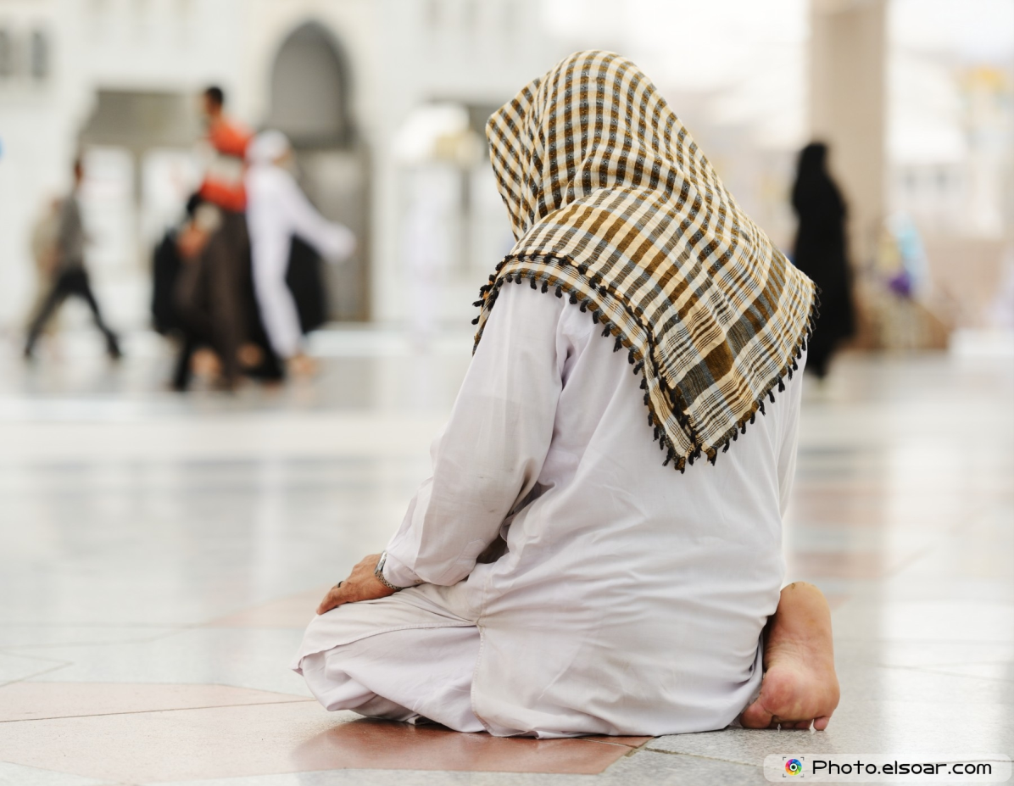
Can you find another Prophet mentioned in the Quran who was also raised in a palace, in a very corrupt society and has been referred to as one of the Muhsineen?

Slide 7
When he came of age, We gave him judgement and [sacred] knowledge, and thus do We reward the virtuous.
Who is this about?

Slide 8
What does Prophet Musa and Prophet Yusuf have in common?
What can we learn from this?

Slide 9
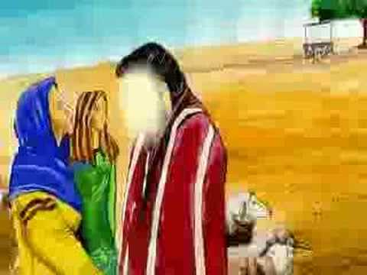
As Prophet Musa (A) lived with his mother for the first few years of his life, he knew who his real mother was. He also respected Lady Asiya a lot and she was very nice to him.
While growing up, he used to visit his parents and siblings in Goshin. This is how he also became really close to Harun who was his brother. The importance of Harun will be discussed later in the story of the life of Prophet Musa (A).

Slide 10
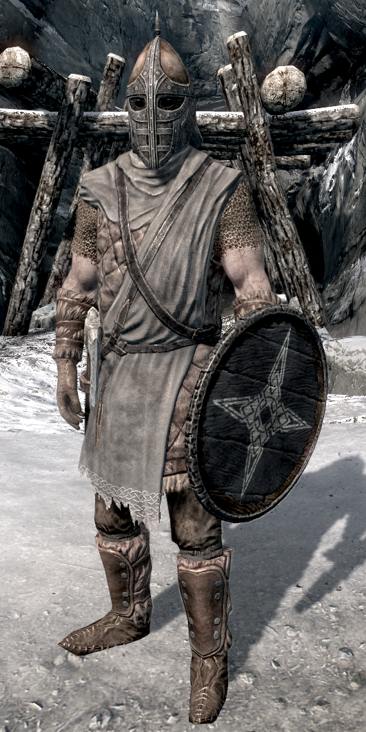
As Prophet Musa (A) was considered a prince, every time he used to visit Goshin, the place where Banu Israil used to live, he would be escorted with guards and officers. Goshin used to be specially prepared for his arrival and all the oppressions such as lashing of the Banu Israil and bad treatment of the Banu Israil would be hidden from the sight of Prophet Musa (A).

Slide 11
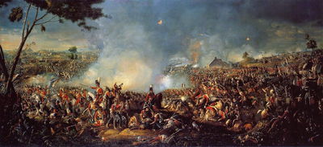
The Banu Israil had many expectations from Prophet Musa (A) as they saw him as a possible leader and saviour for them. Pharoah and his council were beginning to worry about Prophet Musa (A)and his popularity within Goshin and Egypt in general. Pharoah was starting to feel that Prophet Musa would be of danger to him so he kept sending him to different wars and battles so that he might die in battle and Pharaoh would not be held responsible for getting Prophet Musa (A) killed.

Slide 12
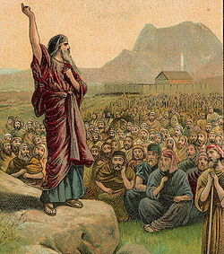
Prophet Musa (as) had a soft spot for the Banu israeel. He wanted to stop the persecution against them and free them.
What is persecution?

Slide 13
[28:15]
Read this verse and decide what you think happened?

Slide 14
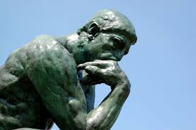
Why is the term Shiah used in the verse?

Slide 15
The term Shiah is not used for tribal or racial links, it is used to express one’s following of a person. Even though Prophet Musa (A) had not reached the stage of prophethood, he was still considered a leader amongst the Banu Israil.
Furthermore, how do you think Prophet Musa (A) life changed after this incident?

