Slide 1
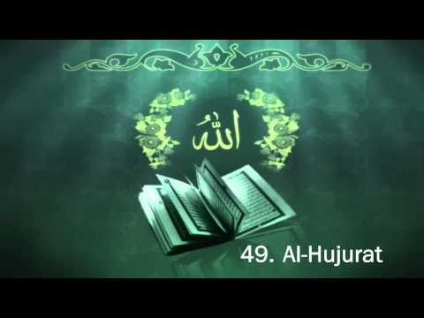
TAFSĪR SŪRAT AL-ḤUJURĀT
Class 7 - LESSON 2

Slide 2
Starter Activity
Which Surahs in the Holy Qur’an have been named after the Holy Prophet (S)?
Sura Taha
Sura Yasin
Sura Muhammad
Sura Muzzammil
Sura Muddaththiir

Slide 3
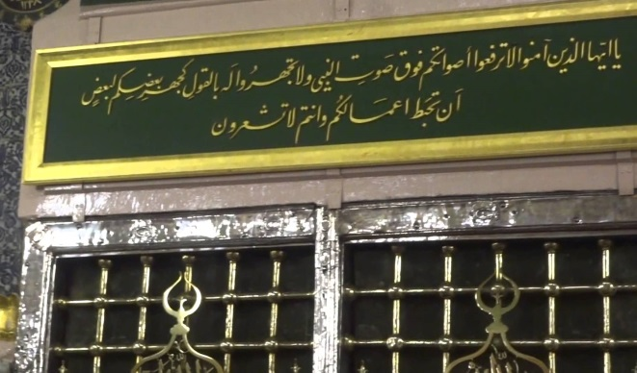
A Study of the 2nd Verse
يَا أَيُّهَا الَّذِينَ آمَنُوا لَا تَرْفَعُوا أَصْوَاتَكُمْ فَوْقَ صَوْتِ النَّبِيِّ وَلَا تَجْهَرُوا لَهُ بِالْقَوْلِ كَجَهْرِ بَعْضِكُمْ لِبَعْضٍ أَنْ تَحْبَطَ أَعْمَالُكُمْ وَأَنْتُمْ لَا تَشْعُرُونَ
[49:2] O Believers! Do not raise your voices above the voice of the Prophet (S). And do not speak loudly to him as you speak loudly to one another, in case your actions are nullified while you remain unaware.
People tried to talk louder than him in argument which was an insult,
People spoke very loudly which was against politeness.
Why do you think this verse uses the adjective nabī, and not rasūl and what is the difference?

Slide 4
A Study of the 2nd Verse Cont…
Protecting one’s good acts from being nullified can be harder than performing them..
Only those acts that arise from taqwa are worthy and accepted by God.
Those who talked over the Prophet (S) did so because they did not have taqwa

Slide 5
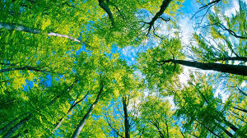
Iḥbāṭ – The Nullifying of Good Acts
Iḥbāt is when God deletes or nullifies the good acts that a person has performed
In another verse in the Qur’an God says:
[47:33] O Believers! Obey God and obey the Messenger, and do not make your deeds worthless. ”
Once the Prophet (S) told his companions:
Whoever recites Subḥānallāh, a tree is planted for him in paradise.
And whoever recites Alḥamdulillāh, a tree is planted for him in paradise.
And whoever recites La ilāha illallāh, a tree is planted for him in paradise.
And whoever recites Allāhu akbar, a tree is planted for him in paradise.”
A man from Quraysh said: O Prophet of God! In that case we will have many trees in paradise
The Prophet (S) replied: Yes indeed! But be careful that you do not send forth fire to burn them to ashes!

Slide 6
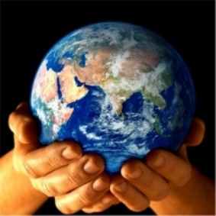
Causes of Iḥbāṭ
There are several causes of iḥbāṭ mentioned in the Qur’an:
Those who are believers in God then change and disbelieve and die as disbelievers.
Those who do good to progress in this world only.
Those who have no belief in God.
Those who disbelieve in the hereafter.
‘Certain actions ruin our good deeds, even as we remain unaware’ Explain the statement using the example of alcohol.

Slide 7
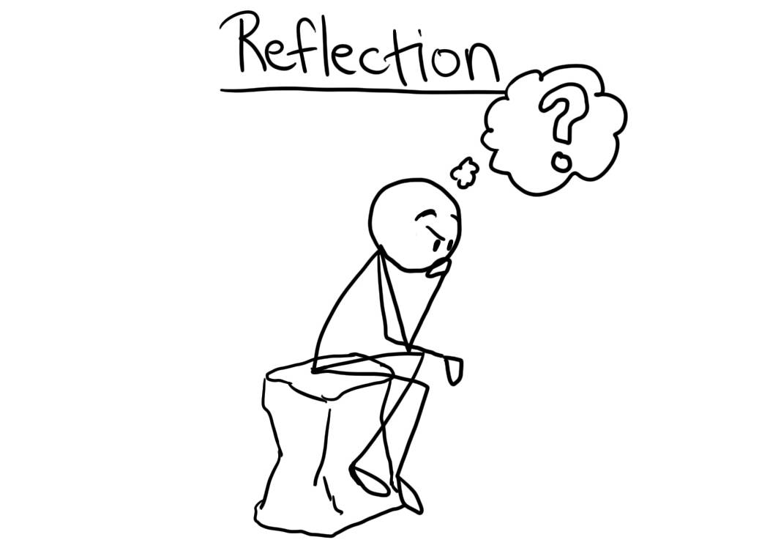
When am I doing actions or speaking for Allah?
When am I doing actions or speaking for This world?

