Slide 1
TAFSĪR SŪRAT AL-ḤUJURĀT
Class 7 - LESSON 5

Slide 2
Starter Activity
What is lying?
How does one lie to oneself?
Do we lie to protect ourselves from harm like being told off?

Slide 3
A Study of the 6th Verse
O Believers! If an open sinner brings you a report then investigate it (before you act) in case you unwittingly hurt the interests of people and regret your conduct afterwards.
Fāsiq is a person who openly defies God’s law and is not repentant. Consequently, such a person will not be worried about lying either.
Thus if a Fāsiq reports something to others, they should not be believed until investigations are made into their claims.

Slide 4
Background to the verse
This verse was revealed about Walīd b. ʿUqba, who was sent by the Prophet (S) to the tribe of Banū Muṣtalīq to collect the zakāt tax.
When they heard that the representative of the Prophet (S) was on his way, they came out to welcome him. Waliḍ was alarmed when he saw their large numbers, especially because there was bad blood between them in pre-Islamic times (jāhiliyya). He thought that they had come to kill him So Walid rushed back to Madina and reported that the Banū Muṣtalīq had refused to pay the zakāt – which was an act of defiance to the authority of the Prophet (S). In effect Walīd was claiming that they had turned apostate (murtad).
The Prophet (S) resolved to fight them, but then this verse was revealed. When investigations was carried out, Walīd’s treachery was exposed.
People cannot be everywhere at once so they rely on other people to inform them of what is happening elsewhere. These sources as well as TV, newspapers, the internet, social media and emails, etc. must all be checked before acting on the information they relay.

Slide 5
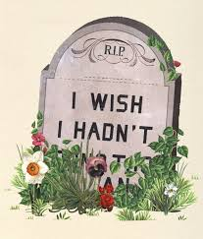
2nd part of verse 6
… in case you unwittingly hurt the interests of people and regret your conduct afterwards
The consequence of acting on unreliable and malicious news is that you may do injustice to innocent people. This can cause lasting damage to people’s lives, well-being and reputation.
Acting hastily on rumours will cause regret later.

Slide 6
The Evil of Lying according to the Qur’an & Hadith
In this verse, God warns us not to listen to an open sinner without investigation.
Lying has been condemned in the Qur’an and hadith and described as one of the worst traits.
Lying is habit forming, and so the best way to avoid it is to always speak the truth, even if it is difficult at times.
There are many traditions from the Ma῾ṣūmīn (A) about lying:
Prophet (S): From amongst God’s punishment to the liar is forgetfulness (of the details of his lies.)
Imam Ali (A): Amongst the signs of faith (īmān) is that you prefer the truth even if it is against your interests, to falsehood even if it to your benefit.
From the above Ahadith when is it okay to lie?

Slide 7
Imam Ali (A): Stay away determinedly from lies, both small and big; because when a person gets used to telling small lies he will gain the audacity to telling big lies.
Imam al-Ṣādiq (A): God the Almighty, likes lying when done to bring about peace between the believers and dislikes the truth when used to create discord amongst them.
Imam al-Ṣādiq (A): Work hard and struggle (to get close to God). And even if you cannot do much, at least do not sin; because whoever builds and does not destroy, his building will rise even though it will be small. As for the one who builds and destroys, it is doubtful that his building will rise at all.

Slide 8
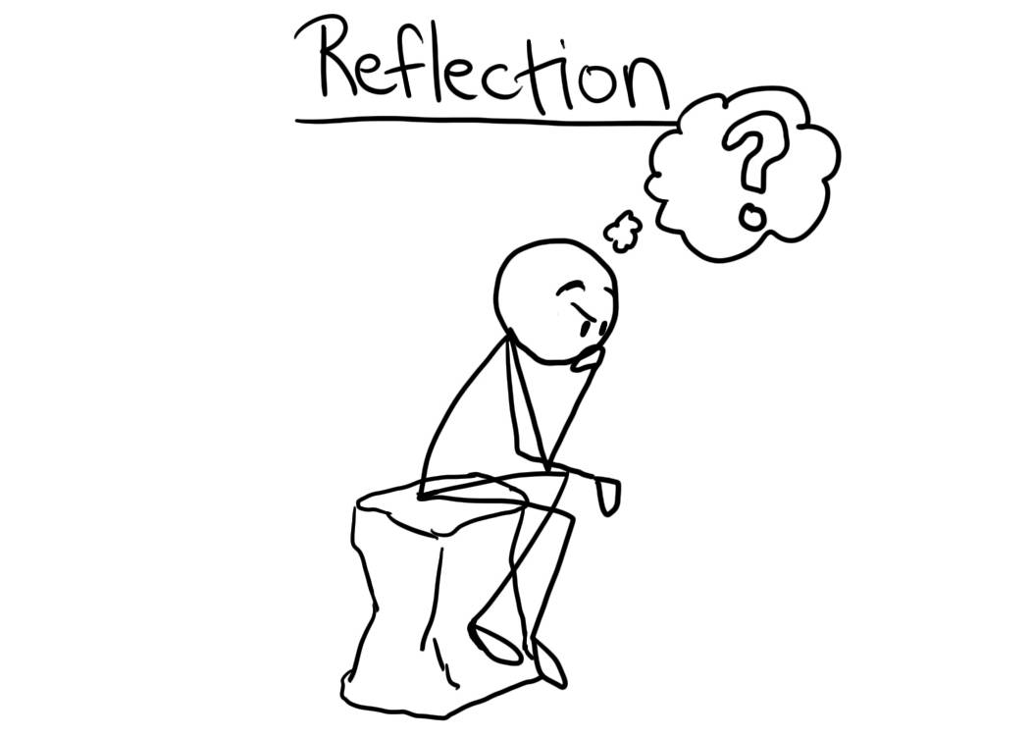
When do I tend to lie?
If I were to die today, what regret do I have? Can I work of changing them before I truly die.

