Slide 1
TAFSĪR SŪRAT AL-ḤUJURĀT
Class 7 - LESSON 7

Slide 2
Starter Activity
Can the believers and non-believers all become one community (Ummah)?
[42:8] And if Allah had pleased He would surely have made them a single community, but He makes whom He pleases enter into His mercy, and the unjust it is that shall have no guardian or helper.

Slide 3
Learning Objectives:
A study of verse 9 and 10 of Surat al-Hujurat

Slide 4
Background of the verses
It is reported that a quarrel broke out between the tribes of Aws and Khazraj, which were the two main Muslim tribes resident in Madina.
As a result, some members of each tribe got into a heated dispute and were ready to draw swords on each other.
At that time this verse was revealed to teach the Muslims how to act in such a situation.
Aws & Khazraj

Slide 5
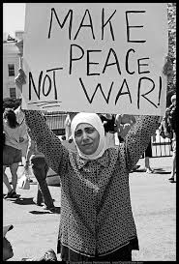
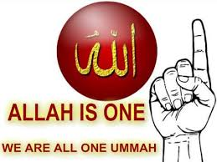
Conflict resolution
The verses teach us how to resolve disputes:
The first duty is to intervene to make peace between members of the community who are in dispute. (Wājib al-Kifā’i)
If there is injustice being down to one party, then the Muslim must back those who are on the side of justice, even if it is against their own friends.
When the crisis is resolved, one must not take revenge or act excessively.
One should attempt to patch up the ill-feeling between the two previously quarrelling parties so that peace can be resumed in the future.
All this is necessary because Muslims are brothers of one another and fostering good ties within the community is a sign of God-consciousness (taqwā).

Slide 6
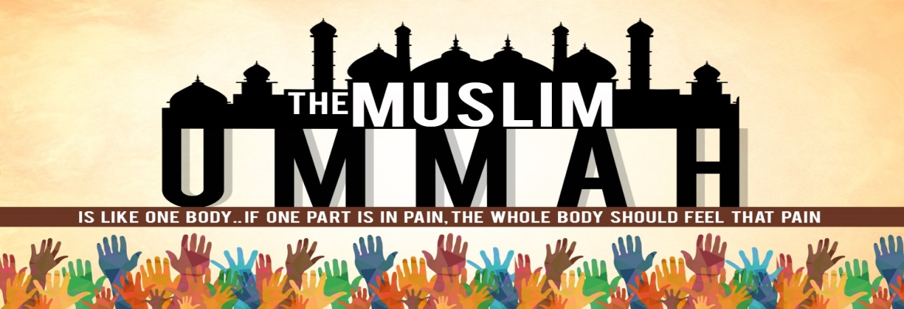
When a community is united and there is love and harmony between its members, it is able to flourish in social, economic and religious activities
God encourages this brotherhood by liberally rewarding activities that bring people closer. For example, there is great reward for eating together, praying together, visiting one another, marriage, etc.
In contrast, there is great punishment for those things that divide the community such as gossiping, breaking ties with relatives, oppressing the vulnerable, etc.

Slide 7
Imam al-Sadiq (A) advised His companion:
The believer has 7 obligatory rights on his fellow believer.
If a Muslim does not care about these rights, then he has come out of the protection of God, and has disobeyed Him.
These rights are:
He loves for him what he loves for himself, and dislikes for him what he dislikes for himself.
He takes pains to fulfil his needs and to make him happy and does not ignore his words.
He helps him with his wealth, strength and speech
He looks out for him, guides him and protects him
He does not let him go without his basic needs
He helps him when he is a vulnerable and poor state
He allocates the best to him and visits him when he is unwell.

Slide 8
How do I like to be treated by others? Can I remember to treat others the same way?
Do I ignore others when they talk to me?

