Slide 1
TAFSĪR SŪRAT AL-ḤUJURĀT
Class 7 - LESSON 8

Slide 2
Starter Activity
Brainstorm: certain knowledge
2nd half of Sura Takhaatur
[102:5] Nay! if you had known with a certain knowledge
[102:6] You should most certainly have seen the hell
[102:7] Then you shall most certainly see it with the eye of certainty;

Slide 3
SŪRAT AL-ḤUJURĀT VERSE 11
O believers! Let not (one) group of men laugh at (another) group of men, it may be that they are better than them; and let not women (laugh) at (other) women, it may be that they are better than them; and do not find fault with each other, nor call one another by nicknames; evil is a bad name after faith, and whoever does not repent, they are the unjust

Slide 4
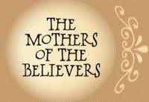
Background and occasion of revelation
There was man called Thābit b. Qays who could hear less, so when he attended mosque, people would give him a place near the Prophet (S) so that he could follow the sermon.
One day he arrived late for the morning prayer and people had already settled down. He started telling them to make way for him so that he could move to the front. At one point one man told him to sit down and stop disturbing the people. Thābit sat down behind him but was very angry. After a while he asked him who he was. When he identified himself, Thābit said. “O so you are the son of that woman?” And he used a derogatory word for his mother, which was how she was known before Islam.
The man became embarrassed and lowered his head. At this point this verse was revealed directing the Muslims to stay away from this sort of behaviour.And the portion about women was revealed about the mother of the believers, Umm Salama, whom the other wives of the Prophet (S) would tease because she wore simple clothes, and was of short stature. Once more the verse forbade them from this practice.

Slide 6
Ethical Guidelines for Social Harmony
This verse gives several ethical (akhlāqī) guidelines that are important for harmony and love to flourish in a society.
Failure to be careful about these matters will bring about false feelings of superiority and arrogance in some, and in time, cause divisions and resentment amongst the members.
These guidelines are:
To abstain from ridiculing others
To abstain from finding fault in others
To abstain from embarrassing others by calling them with nicknames that they dislike
The verse quickly reminds the believers that the one whom they are ridiculing may be more honourable than them in the eyes of God.

Slide 7
A Solution taught by Imam al-Riḍa (A)
The best course is as advised by the Ahlul Bayt (A) – In a long hadith, Imam al-Rida (A) lists 10 qualities of a mature and intelligent believer.
After mentioning the first nine, he said, “As for the tenth, how important it is!” He was asked about it and he said,
[The tenth is that he does not see any other believer except that he says to himself, “He is better than me and more pious.” People will be of two kinds, those who are better than him and more pious and those who are worse than him and more sinful. So when he encounters the person who is worse and more sinful than him, he should say, “Perhaps his goodness is inner and hidden and that is better for him, while mine is apparent and visible and that may be worse for me in the long term.” And when he sees someone better than him and more pious, he is humble before him and gets closer to him. And when he behaves this way, he will have reached the highest level of honour…]

Slide 8
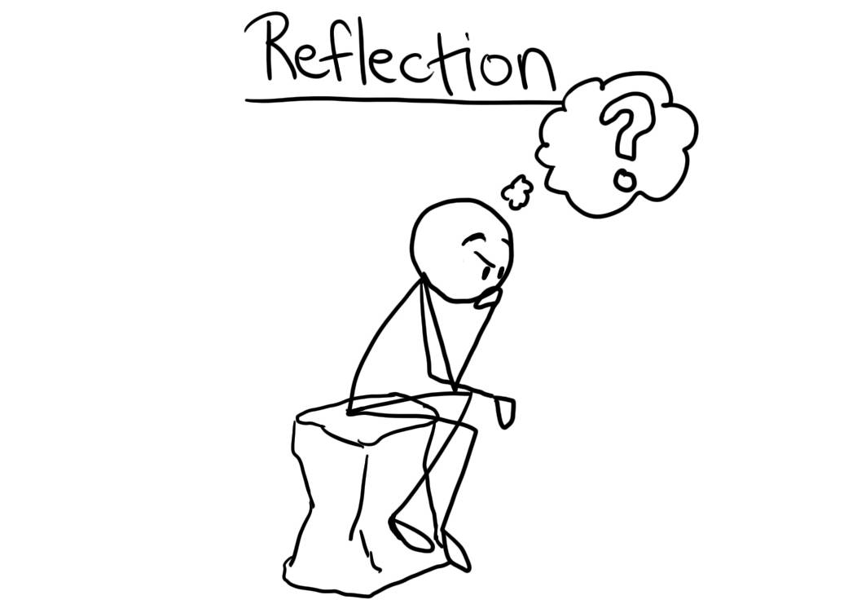
What is the best way to tackle bullying? Knowing that God’s power is with the one who is good and patient.
How do we interact with each other?

