Slide 1
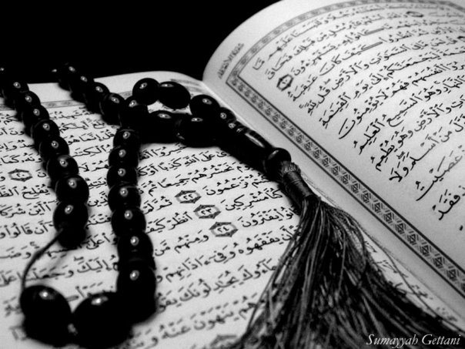
Qur`an Appreciation

Slide 2
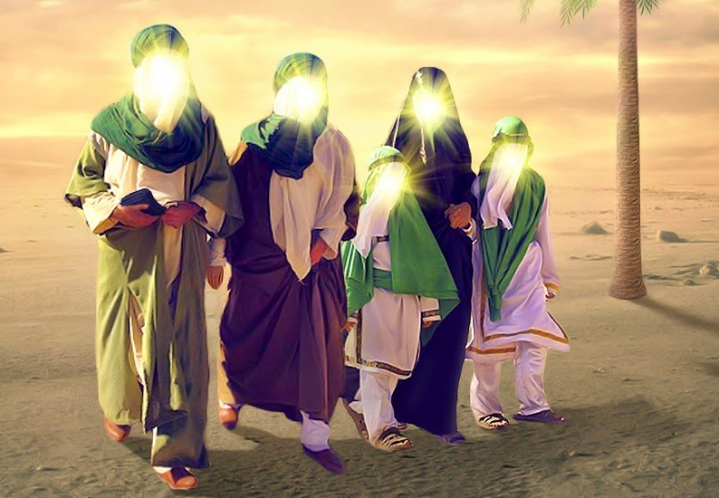
The Ahlul Bayt (as)
in the Holy Qur`an
QA

Slide 3
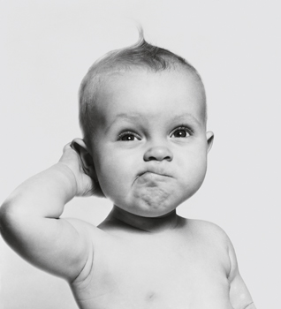
QA
Lesson 1
LO:
Etiquettes of using and reciting the Holy Quran
The Event of Ghadeer
Starter:
What are the other four Divine Books mentioned in the Holy Qur`an?
Notes:
Answer:
Suhuf to Prophet Ibrahim (A)
Zabur to Prophet Dawood (A)
Tawrah to Prophet Musa (A)
Injeel to Prophet Isa (A).
NB. The Qur’an is the only Divine Book that has remained unaltered. The Holy Prophet (saw) took great pains to ensure it was recorded down exactly as he wanted.

Slide 4
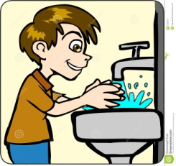
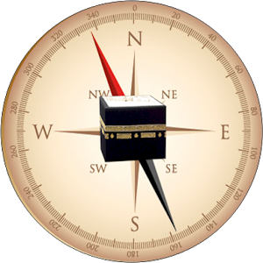
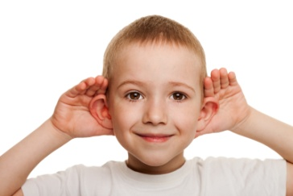
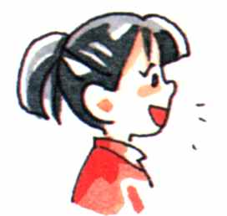
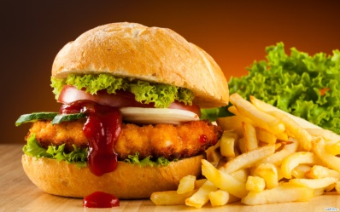
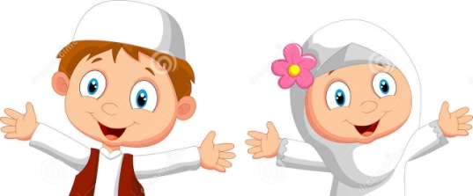
Etiquettes of using & reciting the Holy Quran
QA
1. Do Wudhu BEFORE touching the text
2. Recite أعوذ بالله من الشيطان الرجيم and بسم الله الرحمن الرحيم
3. Face
Qibla
4. Look at the words (even if you know them by heart)
5. Cover
your head
6. Listen carefully and try not to talk or eat
Notes:
NB. Only no.1 is waajib the rest are etiquettes/mustahabaat

Slide 5
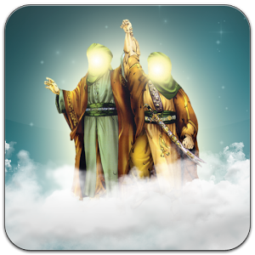
The Event of Ghadeer
QA
What do you know about Ghadeer
Notes:
Test pre knowledge of the children – use prompts such as What, When, Where, Why, Who & How

Slide 6
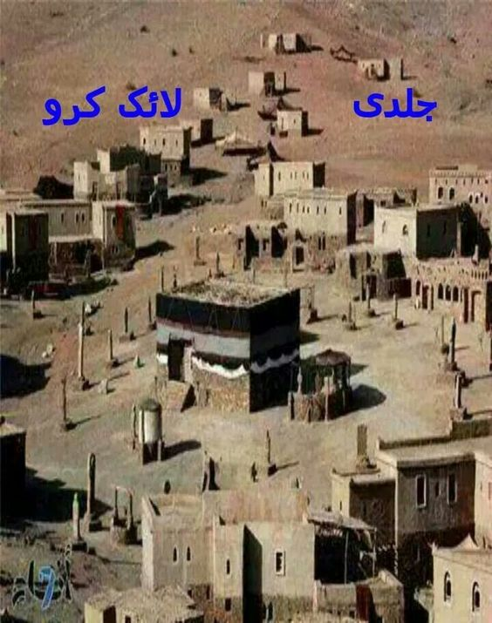
The Event of Ghadeer
QA
Background:
The Holy Prophet (s) went on the first and last Hajj – known as Hajja-tul-Wida in the year 10AH
People from all over Arabia had joined him –making numbers to approximately 100,000
He suddenly stopped at a place between Makkah and Medinah- called Johfah, known then as Ghadeer Khum
There he delivered his Farewell Sermon
Notes:
NB Hajja-tul- Wida = The Farewell Hajj

Slide 7
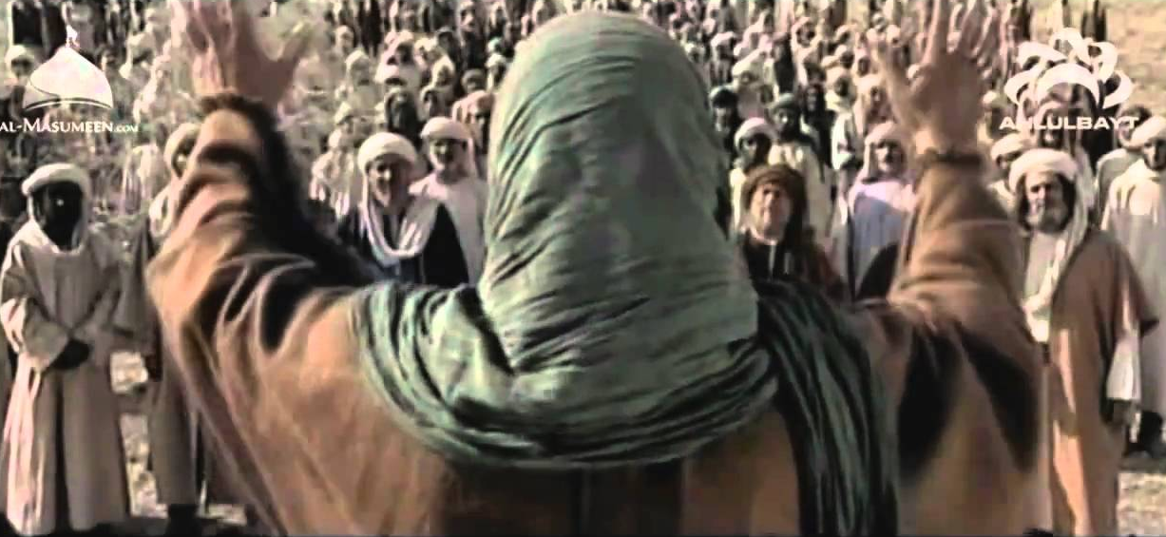
The Event of Ghadeer
QA
He ordered all those who had gone ahead to be called back and waited for those who were following after to join them
Then he had a pulpit of saddles erected so that he was high up and could be seen and heard by everyone

Slide 8
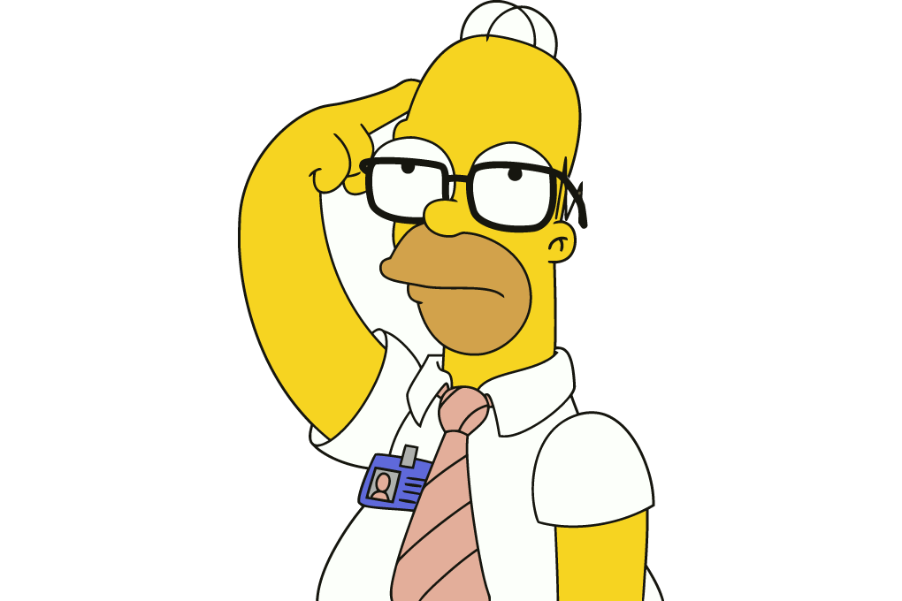
The Event of Ghadeer
QA
He did this because the following verse had been revealed:
and if you do it not, then you have not delivered His message,
“O Messenger! Deliver what bas been revealed to you from your Lord;
and Allah will protect you from the people; surely Allah will not guide the unbelieving people” [5:67]
What is Allah (swt) saying here?
Why is it important?
Notes:
يَا أَيُّهَا الرَّسُولُ بَلِّغْ مَا أُنْزِلَ إِلَيْكَ مِنْ رَبِّكَ ۖ وَإِنْ لَمْ تَفْعَلْ فَمَا بَلَّغْتَ رِسَالَتَهُ ۚ وَاللَّهُ يَعْصِمُكَ مِنَ النَّاسِ ۗ إِنَّ اللَّهَ لَا يَهْدِي الْقَوْمَ الْكَافِرِين
He is saying that if the Holy Prophet (s) doesn’t deliver this announcement, then he has failed in his mission.
The Holy Prophet (s) announcing this one thing, is as important as his whole mission to teach/convey to us the religion of Islam. Therefore it must be so important that he needed as many people as possible to hear

Slide 9
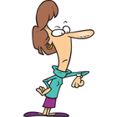
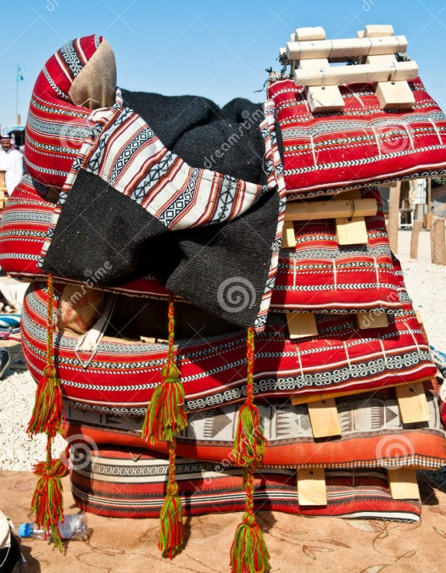
QA
What did the Holy Prophet (swt) do to ensure this important announcement was heard by the maximum number of people?
He waited for those who had gone ahead to come back, and those left behind to catch up
He had a pulpit of stacked Camel Saddles put up

Slide 10
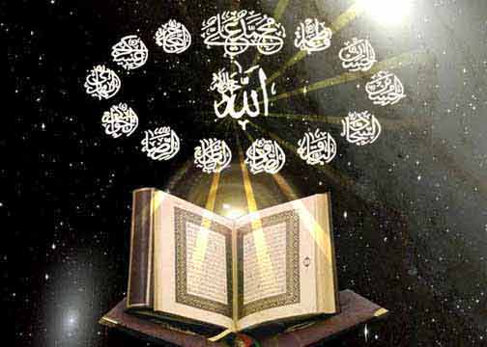
QA
What happened next..?
First he reminded the people of what he had done as the Messenger of Allah (swt)
He also told him that he would be leaving this world soon, then said:
Known as “Hadith Thaqalaiyn”
“I leave you with two weighty things; these are the Qur’an and my Ahlul Bayt. These two will never separate from each other until they meet me in the heaven”
Notes:
Discuss the with the class (time permitting) the incorrect version of the two weighty things being “Qur`an and Sunnah” – why this can not be sound:
Qur`an is Infallible – Sunnah is not (arguments about what makes a sahih hadith), however Ahlul Bayt (as) are
They practice the best Sunnah – so even if it was Qur`an and Sunnah – Ahlul Bayt (as) would still be the best to follow
How can Sunnah – something immaterial meet the Holy Prophet (saw) in Heaven?

Slide 11
QA
What happened next..?
Then he reaffirmed his authority over his Ummah
Then he held Imam Ali (as)’s hand and raised it up so high that the whole assembly of men and women saw him clearly and said:
“To whomsoever I am the Mawla, this Ali is his Mawla (he repeated this 3 or 4 times) O Allah! Love him who loves Ali, and hate him who hates Ali”
Notes:
مَنْ كُنْت مَوْلَاهُ فِعْلِيٌّ مَوْلاهُ

Slide 12
What happened next...
QA
It was after this that Allah (swt) revealed the following verse:
“This day have I perfected for you your religion and completed My favour on you and chosen for you Islam as a religion” [5:3]
Notes:
…الْيَوْمَ أَكْمَلْتُ لَكُمْ دِينَكُمْ وَأَتْمَمْتُ عَلَيْكُمْ نِعْمَتِي وَرَضِيتُ لَكُمُ الْإِسْلَامَ دِينًا

Slide 13
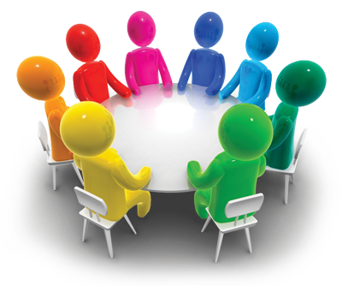
Plenary
QA
Group work:
1. What measures did Allah (swt) and the Holy Prophet (saw) take to ensure this message reached us today?
2. Why did Allah (swt) reveal verse 5:3 after this announcement – how/why did our religion become perfected/completed through this?
Thinking points:
Verses Revealed
Last Hajj of the Prophet
Imamah
Notes:
Use the thinking points to try to get class to discuss the importance of this event – and why/how Imamah was the final thing that the Prophet (saw) had to announce
NB – The steps taken to ensure this message reaches us has already been discussed and repeated during the lesson – however this should be summarised to reinforce their learning

