Slide 1
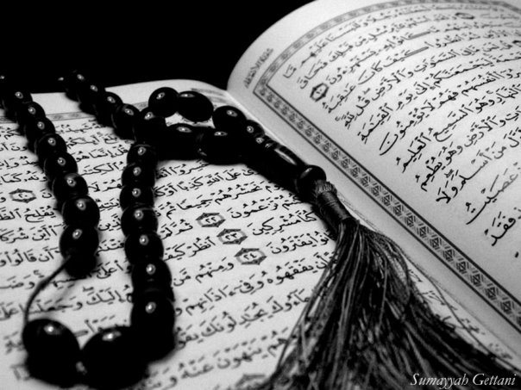
Qur`an Appreciation

Slide 2
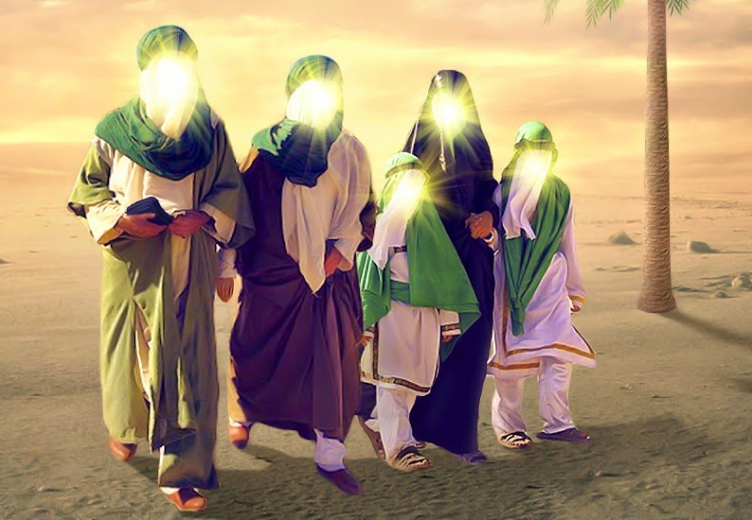
The Ahlul Bayt (as)
in the Holy Qur`an
QA

Slide 3
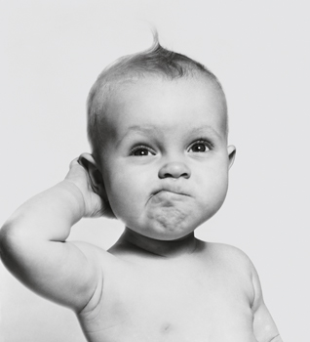
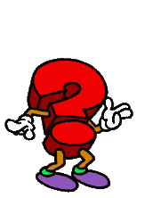
QA
Lesson 3
Starter:
Using the Quraanic verse below, what do you predict today’s Learning Objective is?
Should anyone argue with you concerning him, after the knowledge that has come to you, say, ‘Come! Let us call our sons and your sons, our women and your women, our souls and your souls, let us pray earnestly, and call down Allah’s curse upon the liars.’ [3:61]
LO:
Notes:
Have one student read the verse out loud and as a class or in small groups let students discuss the context the verse was revealed.
Answer: Verse of Mubahila

Slide 4
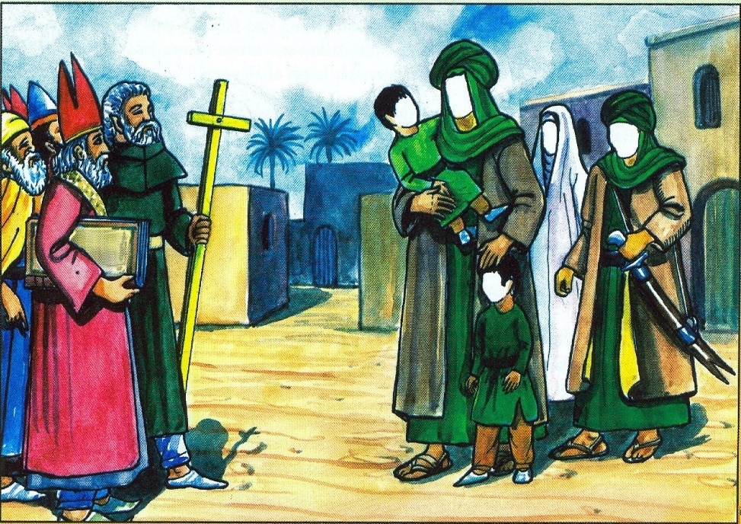
The Event of Mubahila
QA
Use the image below and what you already know to predict what happened during the event of Mubahila:
Notes:
Test pre knowledge of the children – use prompts such as What, When, Where, Why, Who & How

Slide 5
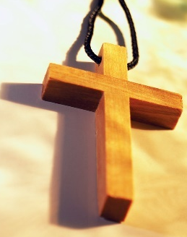
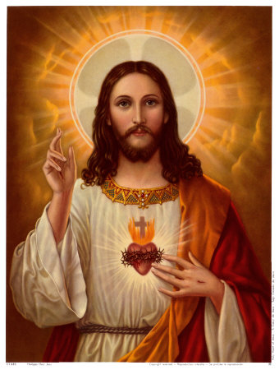
The Event of Mubahila
QA
The prophet sent invitations to all to accept the true religion of Islam.
One invitation was sent to the Christians of Najran.
They sent 60 scholars to discuss the matter with the Holy Prophet
They discussed Prophet Isa (A) believing that Prophet Isa (A) was the son of God
What do you predict happened next?
Notes:
Pick students at random to answer the question in red

Slide 6
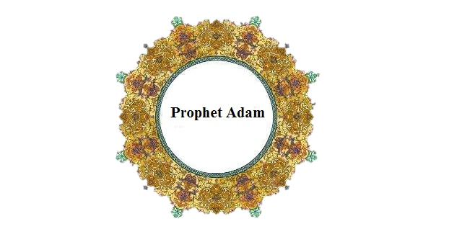
What happened next?
QA
Verse 3:59 was revealed:
إِنَّ مَثَلَ عِيسَىٰ عِنْدَ اللَّهِ كَمَثَلِ آدَمَ ۖ خَلَقَهُ مِنْ تُرَابٍ ثُمَّ قَالَ لَهُ كُنْ فَيَكُونُ
[3:59] Surely the likeness of Isa is with Allah as the likeness of Adam; He created him from dust,
then said to him, Be, and he was.
They discussed other matters but they still did not agree with the Prophet (S.A.W)
Notes:
Pause before showing the answer and allow students to come up with responses

Slide 7
QA
Verse of Mubahila
Verse 3:61:
فَمَنْ حَاجَّكَ فِيهِ مِنْ بَعْدِ مَا جَاءَكَ مِنَ الْعِلْمِ فَقُلْ تَعَالَوْا نَدْعُ أَبْنَاءَنَا وَأَبْنَاءَكُمْ وَنِسَاءَنَا وَنِسَاءَكُمْ وَأَنْفُسَنَا وَأَنْفُسَكُمْ ثُمَّ نَبْتَهِلْ فَنَجْعَلْ لَعْنَتَ اللَّهِ عَلَى الْكَاذِبِينَ
Should anyone argue with you concerning him, after the knowledge that has come to you, say, ‘Come! Let us call our sons and your sons, our women and your women, our souls and your souls, let us pray earnestly, and call down Allah’s curse upon the liars.’ [3:61]

Slide 8
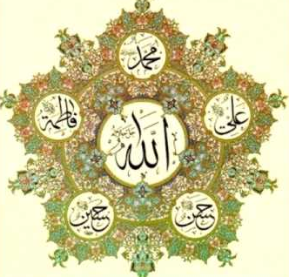
QA
What happened next?
The Holy Prophet (SAW) brought only his close family members:
Imam Ali (a.s.), Bibi Fatima (a.s.), Imam Hassan (a.s.)and Imam Husayn (a.s.)
When the Christians saw this they were afraid that if these people were to pray to Allah (swt) even the mountains could be moved
Instead of participating in Mubahila they immediately requested a settlement.
Notes:
Then the holy Prophet (SAW) raised his hands to the heaven and said:
O my Lord! These are the people of my house

Slide 9
QA
Why did the Holy Prophet (S.A.W) take these 4 personalities?
(Think, pair share)
They represented his sons, women, and selves
They were partners in the claim of the Messenger of Allah (swt) and his mission.
It is one of the most excellent virtues which were given exclusively to these family members of the Prophet.
Notes:
Give students a minute to think of the answer individually.
Then give students a minute to discuss with the person they are seated next to.
Then select a pair at random to share their answer
You can connect this with the prior Hadith-e-Kisa lesson.

Slide 10
Plenary
QA
Group work:
1. Summarise what happened during Mubahila.
2. How are the verses of Tathir and Mubahila similar?

