Slide 1
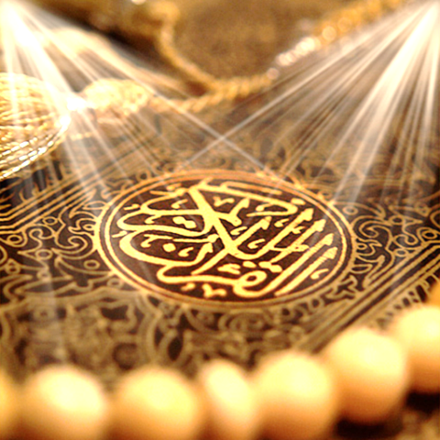
Quran Appreciation

Slide 3
Lesson 5
LO: Studying verses 11-12
Review/ Recap
Starter:
What surah in the Holy Quran has 2
What surah doesn’t have a bismillah?
Notes:
Answer : sura naml has 2 bismillah
Sura tawbah /sura baraat doesn’t have

Slide 4
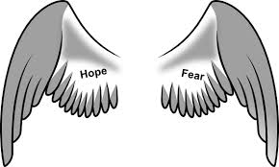
إِنَّمَا تُنذِرُ مَنِ اتَّبَعَ الذِّكْرَ وَخَشِيَ الرَّحْمَٰنَ بِالْغَيْبِ ۖ فَبَشِّرْهُ بِمَغْفِرَةٍ وَأَجْرٍ كَرِيمٍ
You can only warn him who follows the reminder and fears the Beneficent Allah in secret; so announce to him forgiveness and an honorable reward. [36:11]
“…fears the Beneficent Allah” (khashiya al-Rahman وَخَشِيَ الرَّحْمَٰن): why would you fear al-Rahman?
This refers to the twofold balanced perspective of the believer towards Allah (SWT).
On the one hand, acknowledging to the Greatness and Majesty of Allah (SWT), leads to fear and awe.
On the other hand, acknowledging His great Mercy leads on to have hope.

Slide 5
إِنَّا نَحْنُ نُحْيِي الْمَوْتَىٰ وَنَكْتُبُ مَا قَدَّمُوا وَآثَارَهُمْ ۚ وَكُلَّ شَيْءٍ أَحْصَيْنَاهُ فِي إِمَامٍ مُّبِينٍ
Indeed it is We who revive the dead and write what they have sent ahead and their effects [which they left behind], and We have figured everything in a manifest Imam. [36:12]
Notes:
The believers nurture the khashiya of Allah (SWT) whilst living in this world, where the truth of the spiritual realities is not manifest.
After death, the veils will be removed from the spiritual eyes of every human being, allowing them to see the spiritual realms.
The test of this world is to develop this khashiya of Allah (SWT), whilst these realities are hidden

Slide 6
All our good and bad deeds are being recorded on a continuous basis by the two angels dedicated to each human being.
However, this recording is not like the way we record things using a camera. This recording captures all aspects of each action – the apparent action, the intention behind it, the causes, the consequences, etc.
The two angels themselves are the vessels of the recording– they are the recorders as well as the records themselves.
The nature of good deeds and bad deeds are very different and hence, two different angels are required – one as a record of our good actions and the other as the record of our bad actions.

Slide 7
‘Illiyeen and Sijjeen:
After a person dies, his/her book of deeds (which are actually his/her two angels) are stored as individual “chapters” in an even greater more comprehensive “book” (an even greater angel).
The greater book that keeps the records of the good-doers is called ‘Illiyyeen and the greater book which keeps the records of the evil-doers is called Sijjeen.

Slide 8
‘Illiyeen:
كَلَّا إِنَّ كِتَابَ الْأَبْرَارِ لَفِي عِلِّيِّينَ
Nay! Most surely the record of the righteous shall be in the Iliyin.
وَمَا أَدْرَاكَ مَا عِلِّيُّونَ
And what will show you what is Illeeyun?
كِتَابٌ مَّرْقُومٌ
It is a written record,
يَشْهَدُهُ الْمُقَرَّبُونَ
Those who are drawn near (to Allah) shall witness it. [83:18-21]
Sijjeen
كَلَّا إِنَّ كِتَابَ الْفُجَّارِ لَفِي سِجِّينٍ
Indeed, the record of the vicious is in Sijjeen.
وَمَا أَدْرَاكَ مَا سِجِّينٌ
And what will show you what is Sijjeen?
كِتَابٌ مَّرْقُومٌ
It is a written record. [83:7-9]

Slide 9
Complete Task sheet and discuss answers together
Notes:
If time allowing- split class into two teams and ask questions from previous lessons- story of habib najjar, how quran was revealed. Look at previous slides.

