Slide 1
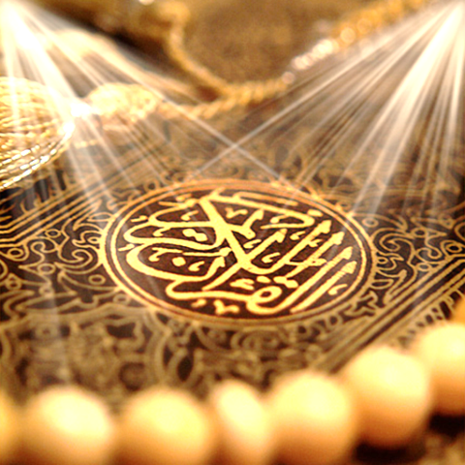
Quran Appreciation

Slide 3
Lesson 7
LO: To study verses 18 and 19
An introduction to the story of Sahib Yasin mentioned in verses 20 onwards
Starter:
Do you know any suwer that start with disjointed letters ? (hurooful muqataat? E.g Ya Seen
Notes:
Answers:
Sura al-BaqarahʾAlif Lām Mīm ألمĀl ImrānʾAlif Lām Mīm ألمal-AʿrāfʾAlif Lām Mīm Ṣād ألمصYūnusʾAlif Lām Rāʾ ألرHūdʾAlif Lām Rāʾ ألرYūsufʾAlif Lām Rāʾ ألرAr-RaʿdʾAlif Lām Mīm Rāʾ ألمرIbrāhīmʾAlif Lām Rāʾ ألرal-ḤijrʾAlif Lām Rāʾ ألرMaryamKāf Hāʾ Yāʾ ʿAin Ṣād كهيعصṬāʾ HāʾṬāʾ Hāʾ طهash-ShuʿārāʾṬāʾ Sīn Mīm طسمan-NamlṬāʾ Sīn طسal-QaṣaṣṬāʾ Sīn Mīm طسمal-ʿAnkabūtʾAlif Lām Mīm ألمar-RūmʾAlif Lām Mīm ألمLuqmānʾAlif Lām Mīm ألمas-SajdahʾAlif Lām Mīm ألمYāʾ SīnYāʾ Sīn يسṢādṢād صGhāfirḤāʾ Mīm حمFuṣṣilatḤāʾ Mīm حمash-ShūráḤāʾ Mīm; ʿAin Sīn Qāf حم عسقAz-ZukhrufḤāʾ Mīm حمAl DukhānḤāʾ Mīm حمal-JāthiyaḤāʾ Mīm حمal-AḥqāfḤāʾ Mīm حمQāfQāf قAl-QalamNūn ن

Slide 4
قَالُوا إِنَّا تَطَيَّرْنَا بِكُمْ ۖ لَئِن لَّمْ تَنتَهُوا لَنَرْجُمَنَّكُمْ وَلَيَمَسَّنَّكُم مِّنَّا عَذَابٌ أَلِيمٌ
[36:18]
They said, ‘Indeed we take you for a bad omen. If you do not desist we will stone you, and surely a painful punishment will visit you from us.’
قَالُوا طَائِرُكُم مَّعَكُمْ ۚ أَئِن ذُكِّرْتُم ۚ بَلْ أَنتُمْ قَوْمٌ مُّسْرِفُونَ
[36:19] They said, ‘Your bad omens attend you. What! If you are admonished.... Indeed, you are an unrestrained lot.’

Slide 5
The rulers of the community stubbornly rejected the arguments of the messengers. Yet the messengers returned to the community and continued to preach their message.
Around the same time as the coming of these messengers to the community, some difficulties had started afflicting the community, possibly as a result of their sins and as a Divine warning for the people to change their ways.
According to some mufassirun of the Qur’an, rain stopped for a long period of time.

Slide 6
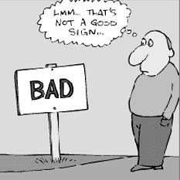
However, instead of taking this as a Divine sign, the rulers blamed the messengers for this, referring to them as “bad omen” and threatening them with death by stoning if they did not stop.
The messengers replied to them informing them that if misery, misfortune, and evil events have come into their society, they should realise that this is a direct consequence of their evil deeds, as opposed to the preaching of the messengers.
misery

Slide 7
Verses 20-22
وَجَاءَ مِنْ أَقْصَى الْمَدِينَةِ رَجُلٌ يَسْعَىٰ قَالَ يَا قَوْمِ اتَّبِعُوا الْمُرْسَلِينَ
[36:20] There came a man hurrying from the city outskirts. He said, ‘O my people! Follow the prophets!
اتَّبِعُوا مَن لَّا يَسْأَلُكُمْ أَجْرًا وَهُم مُّهْتَدُونَ
[36:21] Follow them who do not ask you any reward and they are rightly guided.
وَمَا لِيَ لَا أَعْبُدُ الَّذِي فَطَرَنِي وَإِلَيْهِ تُرْجَعُونَ
[36:22] Why should I not worship Him who has originated me, and to whom you shall be brought back?
What do you understand by these verses?
Discuss with the person next to you ☺

Slide 8
Did you know that they are 3 individuals that have stood out from the rest of mankind?
3
Holy Prophet (S): “The foremost of (the people of) all nations are three – they did not associate any partners to Allah even for a blinking of an eye: Ali b. Abi Talib; Saahib Yasin; and Mu’mim Aal Fir’awn”
Notes:
Imam Ali (A), the one who always gave precedence to the Holy Prophet (S) over himself throughout his life, such that the Qur’an refers to him as the “self” (nafs) of the prophet.
As for Mu’min Aal Fir’awn (the believer from the family of Fir’awn) and Saahib Yasin (the person mentioned in Surat Yasin), their stories have a lot of similarities.
Explained the second two on next slide.

Slide 9
Mu’min Aal Fir’awn was a very prominent member of the family of Fir’awn during the life of Prophet Musa (A)
Some reports suggest that he was the heir apparent of Fir’awn and someone who was influential enough to raise an objection to Fir’awn with regards to the killing of Musa (A).
He rejected the religion of the Egyptians, he was from a group of believers who followed the teachings that Prophet Yusuf (A) had introduced in Egypt many hundreds of years ago
After Musa (A) accidentally killed one of the soldiers of Fir’awn, Fir’awn plotted to have Musa (A) killed. When Mu’min Aal Fir’awn found out about this, he rushed to inform Musa (A) about the plot and advise him to flee Egypt.
Both Mu’min Aal Fir’awn and Saahib Yasin were killed for defending and declaring their faith in the messengers of their times.
Notes:
In Surat al-Ghaafir, Allah (SWT) describes him as:
... رَجُلٌ مُّؤْمِنٌ مِّنْ آلِ فِرْعَوْنَ يَكْتُمُ إِيمَانَهُ ...
…a man from the family of Fir’awn, who concealed his faith… (40:28)

Slide 10
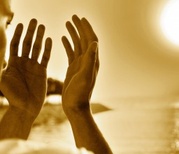
Saahib Yasin
Many reports mention that his name was Habib Najjaar.
He lived in the remotest part of the city the messengers were sent to.
He was a very spiritual man who worshipped Allah (SWT) in seclusion.
He was respected by the people of the community because of his great spirituality, although they were always under the impression that he worshipped the same gods as them, not Allah (SWT).

Slide 11
Saahib Yasin
Some reports suggest that when the messengers were heading towards the city where the people lived, they first passed by the area where he resided and after having spoken to them, this man straight away believed in them and their message.
Later, when he heard that the people were going to kill the messengers, he quickly rushed to them to stop them from committing this grave sin.
Notes:
In the next lesson, we will inshaAllah look at what happened when this man arrived at the city centre where the messengers were preaching.

Slide 12
Plenary
Read verses 20, 21 and 22 together. (previous slide)
In groups/pairs discuss what you have learnt about these ayahs.
Notes:
In the next lesson, we will inshaAllah look at what happened when this man arrived at the city centre where the messengers were preaching.
If time allows- peer check or group chat on previous tasks/homework.

