Slide 1
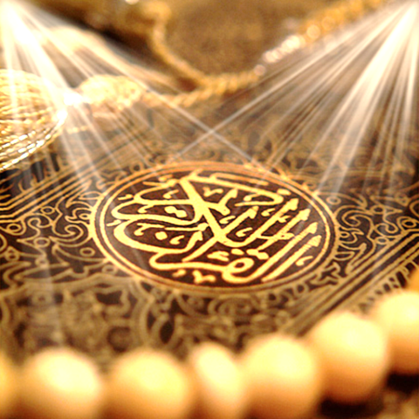
Quran Appreciation

Slide 3
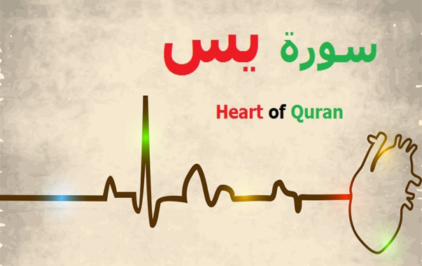
Lesson 8
LO: Look into verses 20 to 26 of Surat Yasin
Continue with the story of Sahib Yasin/Habib Najjar mentioned in verses 20 onwards
Starter:
Play ‘hot seating’ of Habib Najjar
Notes:
Chose 1 person to be Habib Najjar.
Prompt students to ask him questions eg. Why did you believe the messengers so quickly? How did you feel when you heard that the messengers were going to be killed? What did you do then?

Slide 4
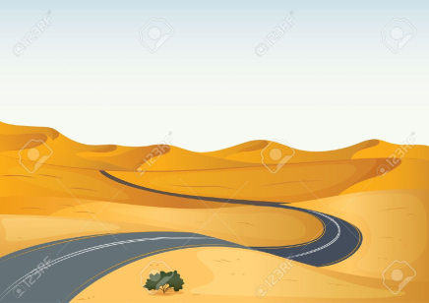
وَجَاءَ مِنْ أَقْصَى الْمَدِينَةِ رَجُلٌ يَسْعَىٰ قَالَ يَا قَوْمِ اتَّبِعُوا الْمُرْسَلِينَ There came a man hurrying from the city outskirts. He said, ‘O my people! Follow the apostles!
As soon as Saabib Yaasin – Habib Najjar – found out the situation in the city and the problems the messengers were going through, despite living in the complete outskirts of the city, he rushed to the aid of the messengers.
Notes:
What do we learn from this –the fact that he rushed despite living so far away?
Link to our lives today-do we ‘rush’ to do ‘good’ in Allah (swt)’s way? Or do we think twice? Maybe give students some time to reflect.

Slide 5
اتَّبِعُوا مَن لَّا يَسْأَلُكُمْ أَجْرًا وَهُم مُّهْتَدُونَ Follow them who do not ask you any reward and they are rightly guided. (21)
1) “Follow them who do not ask you any reward” – This is the first sign of the truthfulness of the messengers. They have no material benefit to gain from their preaching. This is an important argument that all the messengers used when inviting their people to Allah (SWT).

Slide 6
Why do you think none of
the prophets ever asked for
any recompense for their
struggles in preaching to
their people?
Notes:
Answer: So that no one can have an excuse on the Day of Judgement for disbelieving in Allah (SWT) by saying that they couldn’t afford to pay the wages of His prophets in order to get guidance from them!
أَمْ تَسْأَلُهُمْ أَجْرًا فَهُم مِّن مَّغْرَمٍ مُّثْقَلُونَ Or do you ask them for a (financial) reward, so that they are overburdened by a debt? [52:40

Slide 7
ووَمَا لِيَ لَا أَعْبُدُ الَّذِي فَطَرَنِي وَإِلَيْهِ تُرْجَعُونَ
“Why should I not worship Him who has originated me, and to whom you shall be brought back?” [22]
The people of the town believed in Allah (SWT) as the all-Powerful Creator; however, they worshipped various demi-gods in their everyday lives, because they believed that the all-Powerful Creator was too transcendent to help them. Instead, the demi-gods would help them with their everyday needs if they worshipped them instead.
Notes:
What is the point Habib Najjar is trying to make to his people here?

Slide 8
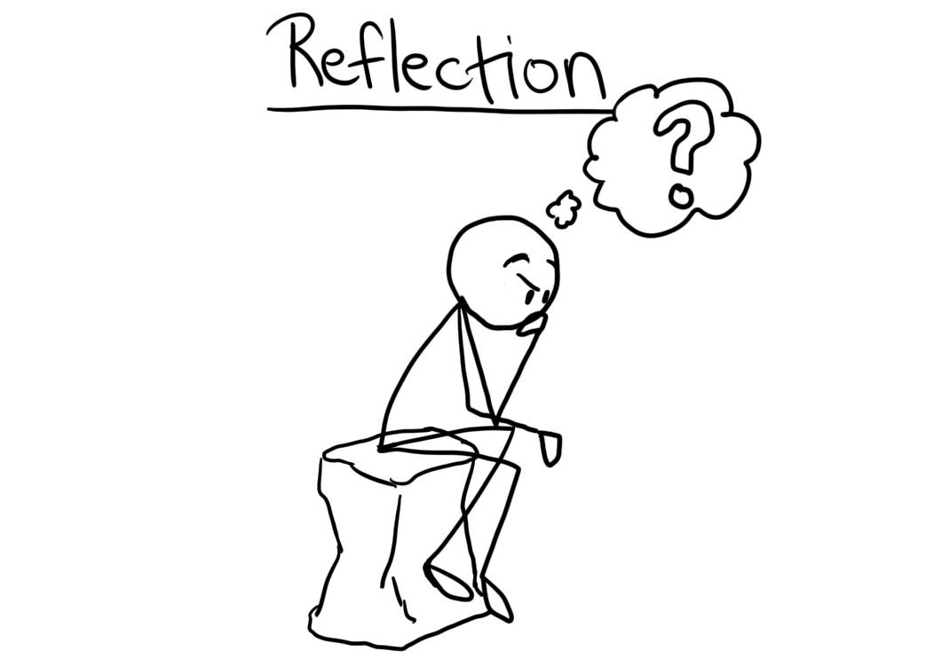
Notes:
Give ch opportunity to discuss and reflect what covered so far
Then work on activity worksheet

Slide 9
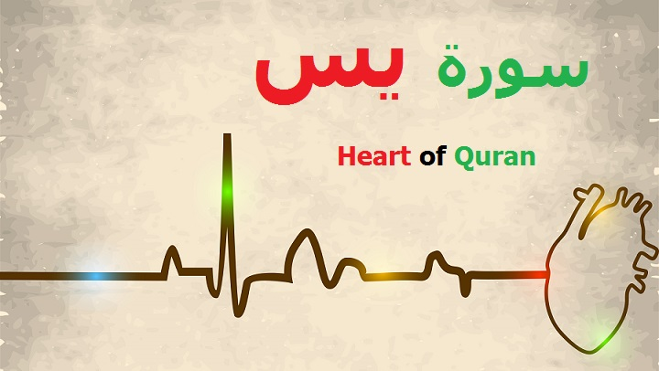
Lesson 6
LO: Look into verses 25-27
Starter:
Get students to
Play ‘continue the verse’.
(see notes on how to play)
Quick recap on what covered so far
Notes:
Select a student to recite any ayah of sura yasin that they can recall.
Then they select another child to say the next one.
Can use Holy Quran if some children not confident

Slide 10
Verse 25-27
إِنِّي آمَنتُ بِرَبِّكُمْ فَاسْمَعُونِ Indeed I have faith in your Lord, so listen to me. قِيلَ ادْخُلِ الْجَنَّةَ ۖ قَالَ يَا لَيْتَ قَوْمِي يَعْلَمُونَ He was told, ‘Enter paradise!’ He said, ‘Alas! Had my people only known بِمَا غَفَرَ لِي رَبِّي وَجَعَلَنِي مِنَ الْمُكْرَمِينَ for what my Lord forgave me and made me one of the honoured ones!’

Slide 11
We looked at the arguments presented by Habib Najjar to his people in support of the messengers.
The people had no intellectual response to Habib’s arguments, so they resorted to violence instead in order to stop him from influencing the people in support of the messengers.
Habib was killed in a very brutal way in order to make an example out of him.

Slide 12
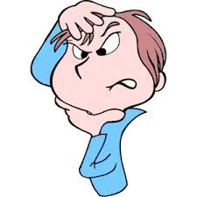
Often when a person is presented with intellectual arguments for which he/she no answer and knows deep down that the arguments are correct, they probably react in 2 ways.
What 2 ways do you think? – Turn to the person next to you and discuss.
Share with class.
Can you think of examples of such situations from your own lives? How did you react when sound advice was given to you? How should you have reacted?
Notes:
Answer:
a) Admit to the correctness of the person’s point and commit to following this new found truth, even if it takes them out of our comfort zones.
b) Reject or ignore the arguments raised and retaliate by making personal attacks (verbal or physical) at the person making the arguments.

Slide 13
قِيلَ ادْخُلِ الْجَنَّةَ ۖ قَالَ يَا لَيْتَ قَوْمِي يَعْلَمُونَ He was told, ‘Enter paradise!’ He said, ‘Alas! Had my people only known بِمَا غَفَرَ لِي رَبِّي وَجَعَلَنِي مِنَ الْمُكْرَمِينَ for what my Lord forgave me and made me one of the honoured ones!’
Up to verse 25 of Surat Yasin, we are told the arguments that Habib Najjar raised with his people.
Very beautifully, the following verses do not directly state the outcome of the conversations between Habib and his people. Instead, the Qur’an straight away jumps to the events directly after Habib’s martyrdom.
Notes:
Why do you think the Qur’an jumps from his arguments with his people to his honoured position after death? What affect does this create?

Slide 14
Why do you think the Qur’an jumps from his arguments with his people to his honoured position after death?
Notes:
Group discussions
Possible answers on next slide

Slide 15
Some possible suggestions:
1) To tell us that the difficult death Habib suffered is actually very insignificant compared to the great bliss he is now living in.
2) To tell us that if we are standing up to support the truth and supporting the oppressed, we should not think about the possible negative consequences that could result in doing this for us, because what we will gain with Allah (SWT) is far greater than the consequences in this world.
3) To show us how quick Allah (SWT) is at rewarding the good doers.

Slide 16
قِيلَ ادْخُلِ الْجَنَّةَ... He was told, ‘Enter paradise!’…
The paradise being referred to here is the paradise in Barzakh (not the paradise in the Hereafter).
Barzakh is the intermediary place between this physical world and the Hereafter.
It is where the souls of the dead reside while awaiting the Day of Judgement and the start of the Hereafter:
Notes:
We will look more into Barzakh next lesson

Slide 17
Brainstorm some things that you can do today that will contribute to your thawab Jaariya and allow you to continue getting rewarded even after your death.
Notes:
Explain Thawab Jariyah- reward of a good deed even after one dies.
We will look more into Barzakh next lesson

