Slide 1
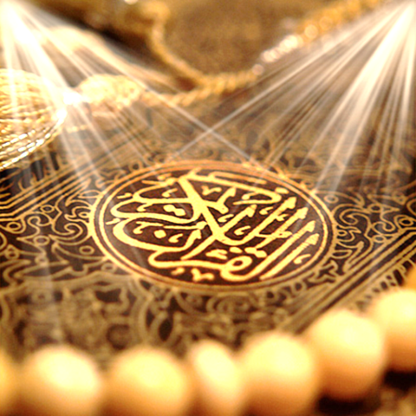
Quran Appreciation

Slide 3
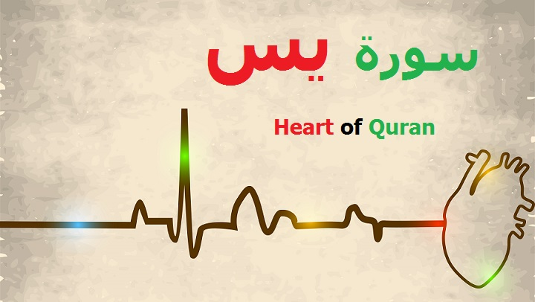
Lesson 9
LO: Look into verses 25-27
Starter:
Get students to
Play ‘continue the verse’.
(see notes on how to play)
Quick recap on what covered so far
Notes:
Select a student to recite any ayah of sura yasin that they can recall.
Then they select another child to say the next one.
Can use Holy Quran if some children not confident

Slide 4
Verse 25-27
إِنِّي آمَنتُ بِرَبِّكُمْ فَاسْمَعُونِ Indeed I have faith in your Lord, so listen to me. قِيلَ ادْخُلِ الْجَنَّةَ ۖ قَالَ يَا لَيْتَ قَوْمِي يَعْلَمُونَ He was told, ‘Enter paradise!’ He said, ‘Alas! Had my people only known بِمَا غَفَرَ لِي رَبِّي وَجَعَلَنِي مِنَ الْمُكْرَمِينَ for what my Lord forgave me and made me one of the honoured ones!’

Slide 5
We looked at the arguments presented by Habib Najjar to his people in support of the messengers.
The people had no intellectual response to Habib’s arguments, so they resorted to violence instead in order to stop him from influencing the people in support of the messengers.
Habib was killed in a very brutal way in order to make an example out of him.

Slide 6
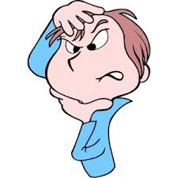
Often when a person is presented with intellectual arguments for which he/she no answer and knows deep down that the arguments are correct, they probably react in 2 ways.
What 2 ways do you think? – Turn to the person next to you and discuss.
Share with class.
Can you think of examples of such situations from your own lives? How did you react when sound advice was given to you? How should you have reacted?
Notes:
Answer:
a) Admit to the correctness of the person’s point and commit to following this new found truth, even if it takes them out of our comfort zones.
b) Reject or ignore the arguments raised and retaliate by making personal attacks (verbal or physical) at the person making the arguments.

Slide 7
قِيلَ ادْخُلِ الْجَنَّةَ ۖ قَالَ يَا لَيْتَ قَوْمِي يَعْلَمُونَ He was told, ‘Enter paradise!’ He said, ‘Alas! Had my people only known بِمَا غَفَرَ لِي رَبِّي وَجَعَلَنِي مِنَ الْمُكْرَمِينَ for what my Lord forgave me and made me one of the honoured ones!’
Up to verse 25 of Surat Yasin, we are told the arguments that Habib Najjar raised with his people.
Very beautifully, the following verses do not directly state the outcome of the conversations between Habib and his people. Instead, the Qur’an straight away jumps to the events directly after Habib’s martyrdom.
Notes:
Why do you think the Qur’an jumps from his arguments with his people to his honoured position after death? What affect does this create?

Slide 8
Why do you think the Qur’an jumps from his arguments with his people to his honoured position after death?
Notes:
Group discussions
Possible answers on next slide

Slide 9
Some possible suggestions:
1) To tell us that the difficult death Habib suffered is actually very insignificant compared to the great bliss he is now living in.
2) To tell us that if we are standing up to support the truth and supporting the oppressed, we should not think about the possible negative consequences that could result in doing this for us, because what we will gain with Allah (SWT) is far greater than the consequences in this world.
3) To show us how quick Allah (SWT) is at rewarding the good doers.

Slide 10
قِيلَ ادْخُلِ الْجَنَّةَ... He was told, ‘Enter paradise!’…
The paradise being referred to here is the paradise in Barzakh (not the paradise in the Hereafter).
Barzakh is the intermediary place between this physical world and the Hereafter.
It is where the souls of the dead reside while awaiting the Day of Judgement and the start of the Hereafter:
Notes:
We will look more into Barzakh next lesson

Slide 11
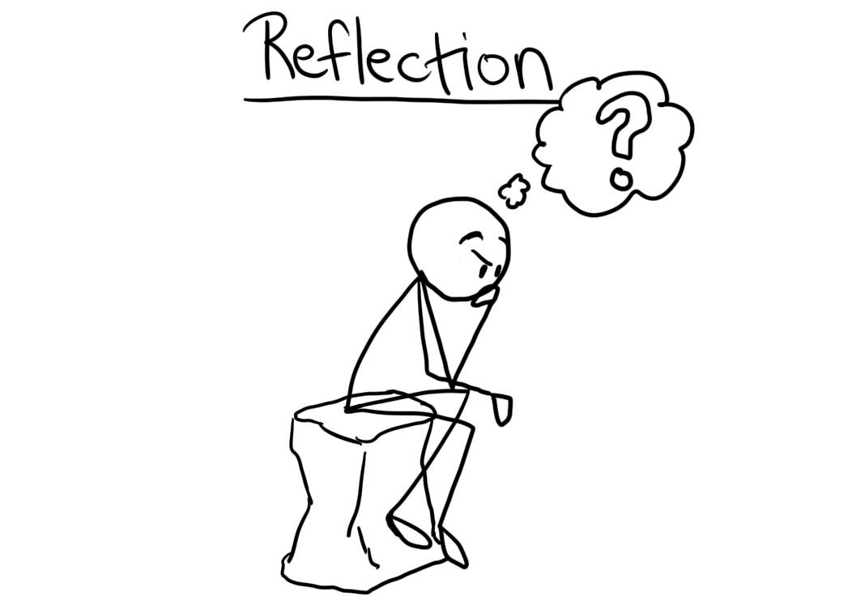
Brainstorm some things that you can do today that will contribute to your thawab Jaariya and allow you to continue getting rewarded even after your death.
Notes:
Explain Thawab Jariyah- reward of a good deed even after one dies.
We will look more into Barzakh next lesson

