Slide 1
Stay Safe
Anti-bullying
Session 1

Slide 2
Personalised Learning Outcomes
ALL: Will identify key reasons that make a bully
MOST: As above and will describe who you can go to if you are or know someone who is being bullied
SOME: As above and will explain the consequences of bullying

Slide 3
Starter: What makes a bully?
Bully

Slide 4
Starter: What makes a bully?
Hitting/kicking/ pushing
Name calling/ Mean words
Damaging property
Stealing
Bully
Threats
Rumours
Teasing
Leaving somebody out

Slide 5
What is bullying?
Bullying includes:
Name calling
Hitting, pinching, biting, pushing and shoving
Damaging your belongings
Stealing your money
Making things up to get you into trouble
Taking things away from you
Taking your friends away from you
Posting insulting messages on the internet or by IM (cyberbullying)
Spreading rumours
Threats and intimidation
Making silent or abusive phone calls
Sending you offensive phone texts
They may make remarks about:
Your weight
Your appearance
Your abilities
Your religion
Your background
Your disability
Your health
Your family
Your accent
It is not good enough to say that something was a “joke” or that it was “teasing”. If it is something negative about another person, it is bullying!

Slide 6
ANTI-BULLYING POSTER
On the paper you have to design your own
ANTI-BULLYING POSTER!

Slide 7
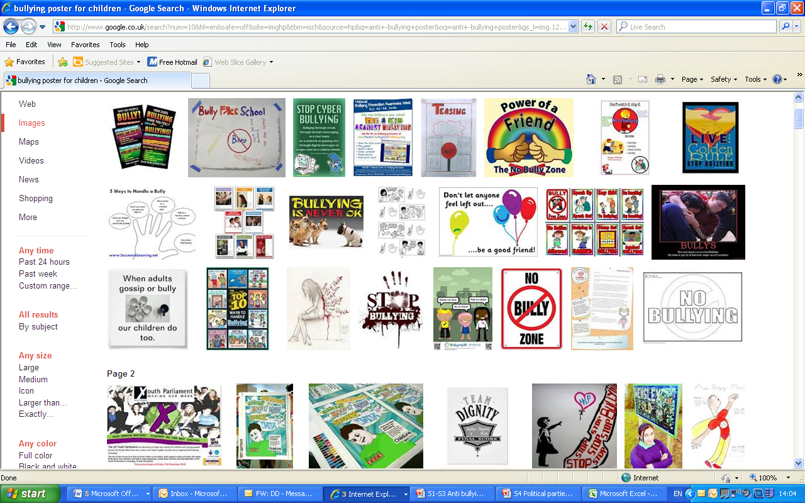

Slide 8
What would you do?
TASK: Group Discussion
The following slides, will give six different scenarios.
You will need to divide yourself into six groups and discuss the best action to take in the scenario given to you.
You then need to feedback and the rest of class will give their opinion.

Slide 9
What would you do?
1. There's a website everyone at school knows about where people have been posting insulting messages about me. My name has been given, the school I attend and the year I am in. Lots of vile and untrue things have been said about me and I don't know what to do. My mum wants to get the police involved but I'm afraid it will make things worse. I don't know who is behind it or how to complain and get the postings removed.

Slide 10
What would you do?
2. My grades at school have gone right down and I'm bunking off when my mum's at work because I can't face all the lessons I have with the bullies. I'm being called names about my weight and I have nobody to go around with at break. When I sit down with my packed lunch the others get up and move away. I'm taking so much time off that my mum is going to find out soon. I've told my head of year and she spoke to them but they're still doing it. This is making me feel very depressed.

Slide 11
What would you do?
3. I'm aged 12 and I'm not getting bullied at school but I get threats from an older girl who goes to my school and lives in my street. We used to be really friendly but we fell out. I get nasty calls on my phone and takeaways and taxis sent to our house. I know she and her friends are behind it because sometimes she's says things in the texts that no one else could know.

Slide 12
What would you do?
4. I'm 14 and I can't face school any more. I want to move to a new one because it can't be any worse than this. I'm always on my own at break and I've got nobody to go around with. I've fallen out with my friends and they're going around with someone who used to bully me.

Slide 13
What would you do?
5. I go to a school with not many pupils from different backgrounds so I stand out. I'm often called names, jokes are told about me and I'm told to go back to where I came from. This is my home! I was born here!
My family don't know what's being said to me and I don't want to upset them by telling them. They don't speak English very well and they might not be able to sort it out for me.

Slide 14
What would you do?
6. There's a lot of fighting on my school bus and there's an older boy who keeps calling me names and having a go at me. My mum says she can't keep leaving work early to pick me up but I'm afraid of what might happen. I live quite a way from the bus stop and I keep thinking the bullies can get me on the way home too.

Slide 15
Consequences
Low self- esteem Poor self- image
Poor grades School refusal
Self- harm Depression
Withdrawal Isolation
Weight loss/ gain Lack of sleep

Slide 16
Statistics
69% of children in the UK report being bullied
87% of parents report that their child had been bullied in the past 12 months
20% report bullying others
85% had witnessed bullying
1 in 5 child deaths in the UK is caused by suicide..could this be due to bullying?
It is estimated that at least 20 children and adolescents a year commit suicide because of being bullied
More than half of those who reported being bullied had been physically hurt
34% of those physically hurt required attention from a doctor or hospital.
3% of the attacks involved a weapon.
1 in 3 young people who experience bullying truant from school

Slide 17
Victims
http://www.youtube.com/watch?v=slIeaNr-rRM
http://www.youtube.com/watch?v=SDcHI8YFQ4w
http://www.youtube.com/watch?v=dI2LF-Te-fE

Slide 18
What do I do?
Tell a friend, tell a teacher and tell your parents.
It can be hard to do this so if you don't feel you can do it in person it might be easier to write a note.
Try to stay in safe areas of the school at break and lunchtime where there are plenty of other people. Bullies don't like witnesses.
If you are hurt at school, tell a teacher immediately and ask for it to be written down. Make sure you tell your parents.
Your form tutor, head of house or guidance manager needs to know what is going on. Try to find a time to tell him/her when it won't be noticeable. You could stay behind on the pretext of needing help with some work.
Use school Speak Up system available on home page during term time
When you started school in year 7 you signed an anti-bullying contract
WHTC has a ZERO TOLERANCE policy on bullying...we will help you

Slide 19
Stay Safe
Anti-bullying
Session 2 and Session 3
Role play and Drama

Slide 20
Learning Objectives
To consider how it feels to be unsafe and develop our empathy for people in a difficult situation.
To understand what is meant by rights and responsibilities when we are talking about bullying.
To discuss how young people being bullied can be supported.
PLTS: reflective learners, team workers

Slide 21
STARTER
I want you to call out the numbers one to ten in order. Only one person at a time can call out one number. If you have called out one number, you should not call out another.
If two people call out the same number, you must start again.
As a class, can you make it to ten?
This task shows you the importance of patience, respect and good communication skills. You will need these skills and qualities for the main task.

Slide 22
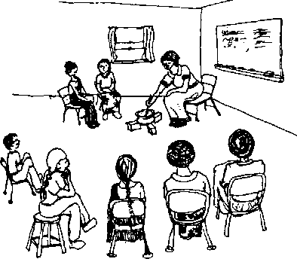
Role Play
TASK: You will work in small groups to create and then present two “freeze frames” of a section of a story that you will be given.
Procedure:
You need to be in groups of about three.
Each group will be given a small section of a story. The number on the handout will tell you what part of the story you will dramatise. Altogether, there are eight sections.
The main characters throughout the story are Ahmed and Zara.
You can add additional characters to your section of the storyline as long as you keep to the main plot.
Work on your section to create TWO freeze frames. Everyone must perform. When you perform, you will present both freeze frames to the class.
Your teacher will tell you when you must stop practising and when to present your section, in order, to the class.
GOOD LUCK
Shhh… don’t tell any other group what is happening in your section.

Slide 23
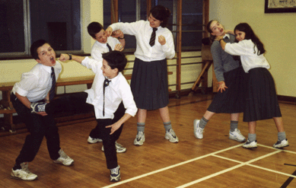
Freeze Frames
A freeze-frame is when the action in a play or scene is frozen, as in a photograph or video frame.
Think about:
Positioning (can everyone see you?)
Facial expressions (is it clear what you are trying to portray?)
Posture (does this represent the feelings of the character?)

Slide 24
Practise
Use your section to create two freeze frames.
You can add or remove characters.
However, you must ensure that the main characters are still involved and that the main plot is adhered to.

Slide 25
Performance
TASK Discuss the following after each section is performed:
What do you think is happening in each section?
How does Zara feel?
How does Ahmed feel?
How does Daniel feel?
Why do they behave in the way that they do?
What would you tell Zara to do?

Slide 26
Section 1
Zara is 12 years old. Her best friend at school is Ahmed. Ahmed is 13.
Zara and Ahmed live in the same neighbourhood so they get the bus to school together. They are also in the same form and have science classes together. They are often caught sharing jokes and enjoying one anothers company.

Slide 27
Section 2
One day a new student joins Ahmed and Zara’s form class. His name is Daniel. Daniel is made to sit near Ahmed and they quickly become friends.
At break, Daniel is with Ahmed when Zara approaches them both. Zara is Ahmed’s good friend, so she thinks it is important to befriend Daniel. She says hello and tries to make conversation. When she leaves, Daniel tells Ahmed that he thinks Zara seems like a geek.

Slide 28
Section 3
A few days later, in form, Zara goes over to her friend Ahmed, who is sitting with Daniel. Very loudly Daniel says “Zara man, chill out, Ahmed doesn’t want you”. The form class laughs. Zara walks back over to her seat. Ahmed doesn’t say anything, he goes along with it.
In science class, Ahmed normally sits next to Zara. He has decided not to. Zara has to find another seat. Someone yells “you got rejected, shame”.

Slide 29
Section 4
In the playground, Zara is hanging out with a few girls. Another girl, Anisa, walks over to the group and says ‘come on girls, we’ve got somewhere to be and it’s not with Anisa’. The girls walk off and leave Zara, upset, by herself.
Daniel is not too far in the distance; he laughs at Zara and yells something horrible at her.

Slide 30
Section 5
Daniel is at home in the living room with his baby brother. In the kitchen next door he can hear his father yell at his mother. His mother isn’t saying much. He hears a thud.
A few minutes later, Daniel’s mother comes quietly into the living room to check on the baby. She is rubbing her shoulder and side.
Daniel’s mother takes the baby and goes upstairs. Daniels father comes into the living room shortly afterward. Daniel’s father orders Daniel to give him the remote and fetch him some food.

Slide 31
Section 6
Zara, who is twelve, is in the kitchen at home with her mum and five year old sister.
Zara has a lot of responsibility at home as her mother has depression. Her mum’s depression has been worse lately and Zara thinks it is because Zara’s father recently remarried.
After Zara has fed, washed and helped her sister into bed, she goes onto the computer. On Facebook, she finds that her friends are posting malicious messages about her.

Slide 32
Section 7
Zara comes into school by herself. As she walks to her form room, some girls call her names. One person even pushes into her as she is walking past.
Zara is upset. She doesn’t want to go to form and she doesn’t want to see her old friend Ahmed and his new friend Daniel. She is worried about what they will say or do. Zara truants by hiding in the toilets.

Slide 33
Section 8
Zara has begun to truant from form and science lessons. Teachers notice and they notify her Head of House.
Her Head of House arranges to see Zara for a meeting. As she goes into her Head of House’s office, she sees Daniel, who whispers “you better not snitch”.
In her meeting, Zara is told to explain her behaviour. When she doesn’t, her Head of House tells her that he must meet her parents because Zara is facing exclusion. Zara is very worried about her parents being notified.

Slide 34
ANTI-BULLYING
WHTC has a ZERO TOLERANCE policy on bullying!

