Slide 1
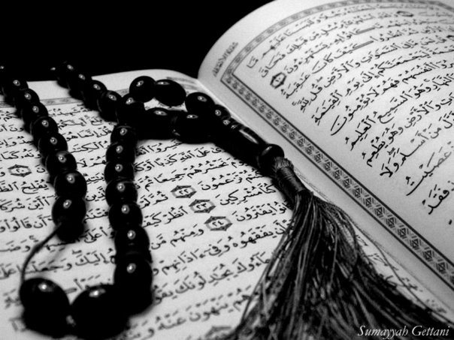
Qur`an Appreciation

Slide 2
QA

Slide 3
Lesson 17
QA
LO:
Studying Verses 63-68
Understanding the events after Prophet Yusuf (as)’s brothers returned home
Starter:
Among the following prophets whose name is mentioned most number of times in the Quran?
Prophet Musa (as)
Prophet Isa (as)
Prophet Ya’qub (as)
Prophet Ibrahim (as)
Notes:
Answer:
Prophet Musa (as)
BONUS: Name three suwer he is mentioned in:
Baqara (2)
Qasas (28)
Kahaf (18)
Taha (20)
Shu’araa (26)
A’raaf (7)
Sajdah (32)
Dhukkhan (44)
There are many more – these are just a few examples

Slide 4
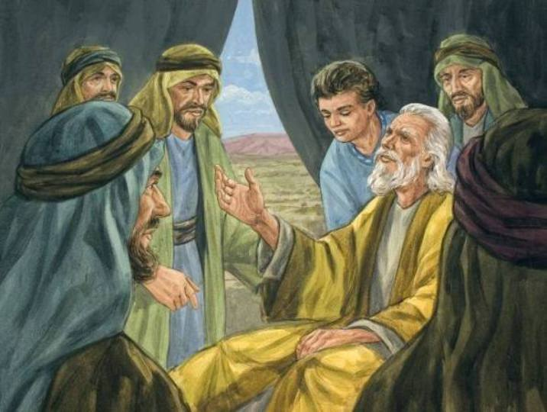
Studying Verses 63 - 68
QA
Vs 63:
Prophet Yusuf (as)’s brothers then returned to Kan‘an rejoicing and well supplied
However, they were worried that about their father not agreeing to send Benyameen back with them
So told their father that the condition for receiving future supplies of grain would be for him to send Benyameen with them to Egypt.

Slide 5
Studying Verses 63 - 68
QA
Vs 63 & 65:
They tried to convince their father by telling him that
The king had favoured them before but withheld an extra share
They would protect their brother
All they needed to do was to take Benyameen with them
This is why it is referred to as “an easy measure”

Slide 6
Studying Verses 63 - 68
QA
Vs 64 & 66:
Prophet Ya’qub (as) expressed that his heart was uneasy with handing over Benyameen to them, just as he had been uneasy with turning over Prophet Yusuf (as) forty years before (he had not forgotten the incident)
However, he states that all matters are in Allah (swt)'s Hands and if He protects Benyameen, then no one can harm him
It was his knowledge of Allah (swt), that gave Prophet Ya'qub (as) any reassurance in sending Benyameen to Egypt.

Slide 7
Studying Verses 63 - 68
QA
Vs 64 & 66:
He made his sons take a solemn oath to Allah (swt) that they would do everything within their power to protect their brother until
they were completely over powered/surrounded OR
(according to some tafaseer) they were killed
It is said that Prophet Ya’qub (as)’s heart was more at ease after they agreed to take the oath, as they had also shown remorse for what had happened with Prophet Yusuf (as)

Slide 8
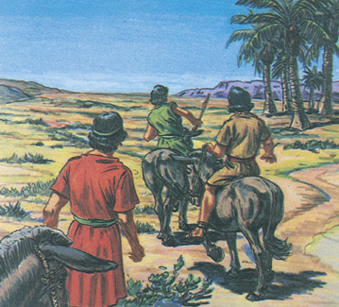
Studying Verses 63-68
QA
Vs 67-68:
Prophet Ya'qub (as) advises his sons to enter into the city by various gates when they return to Egypt
As he did not want them to attract attention and jealousy as they were handsome men and had received special treatment by the ruler of Egypt
Nevertheless, he was quick to point out that it was Allah (swt) that was the final Guarantor and Judge, and that whatever God Almighty has decreed for them, he nor anyone else could prevent it from being fulfilled

Slide 9
Plenary
QA
Group work:
The Qur`an mentions twice the fact that whatever Allah (swt) Wills will happen – what is this trying to teach us?
What do you understand about the way in which Allah (swt) rewards us?
Thinking points:
Trusting in Allah (swt)
Is our reward from Him always immediate?
Notes:
Discussion:
It is only Allah that is the final Guarantor and Judge, and in Him and only Him should we put our trust, and from Him we must seek help, even when we take precautions.
NB that is all we can do – do what we can and rely on Him and leave the rest up to Him and know that whatever He decrees will happen and it’ll be the best for us whether we think the outcome is the best or not – this is true tawakkul
Prophet Ya’qub (as) had been patient for over 40years with the loss of Prophet Yusuf (as), he was now prospectively losing Benyameen – but again he had full tawakkul on Allah (swt) and sent him with his brothers relying on Allah (swt) to protect him
The end of verse 68 also mentions that Prophet Ya’qub (as) had some knowledge by the Grace of Allah (swt) – which gave him some insight into these affairs in which his sons were involved. This insight was due to his communication with God Almighty Who established his knowledge – we also see that as Prophet Ya’qub (as) did not stop striving in the way of Allah (swt) he is rewarded with this special knowledge from Allah (swt).
In the same way we must not stop striving in His way even when we do not see the rewards of our efforts immediately

